Slide 1
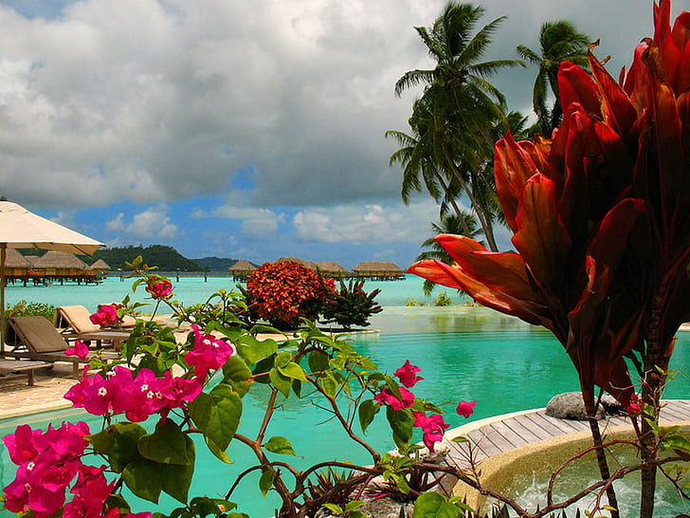
My Dream Vacation
By Ella Hayden

Slide 2
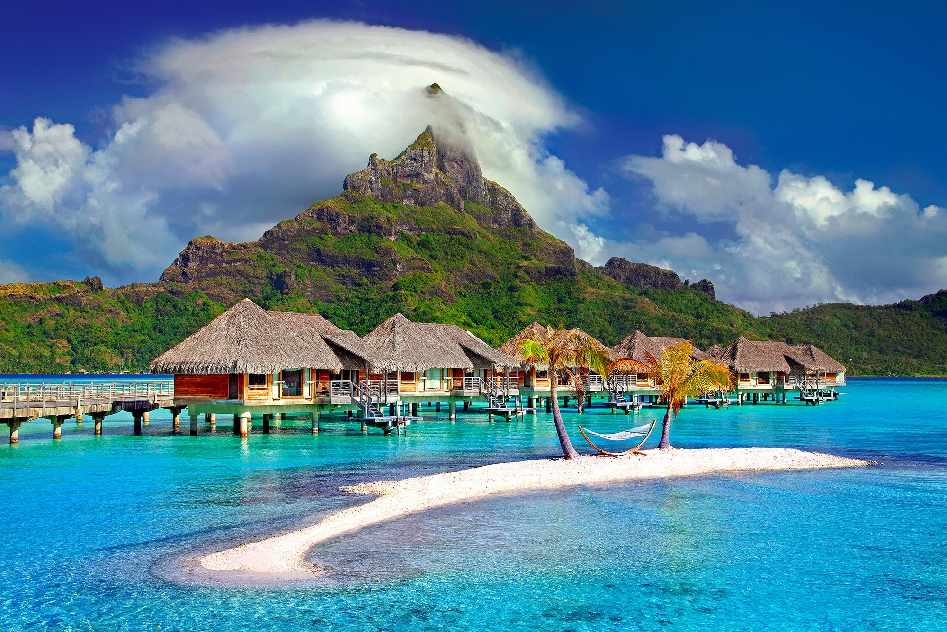
Where I Wish To Travel
My dream vacation would be to go to Bora Bora.
I have always wanted to go there because is full of beauty and the ocean is crystal clear.

Slide 3
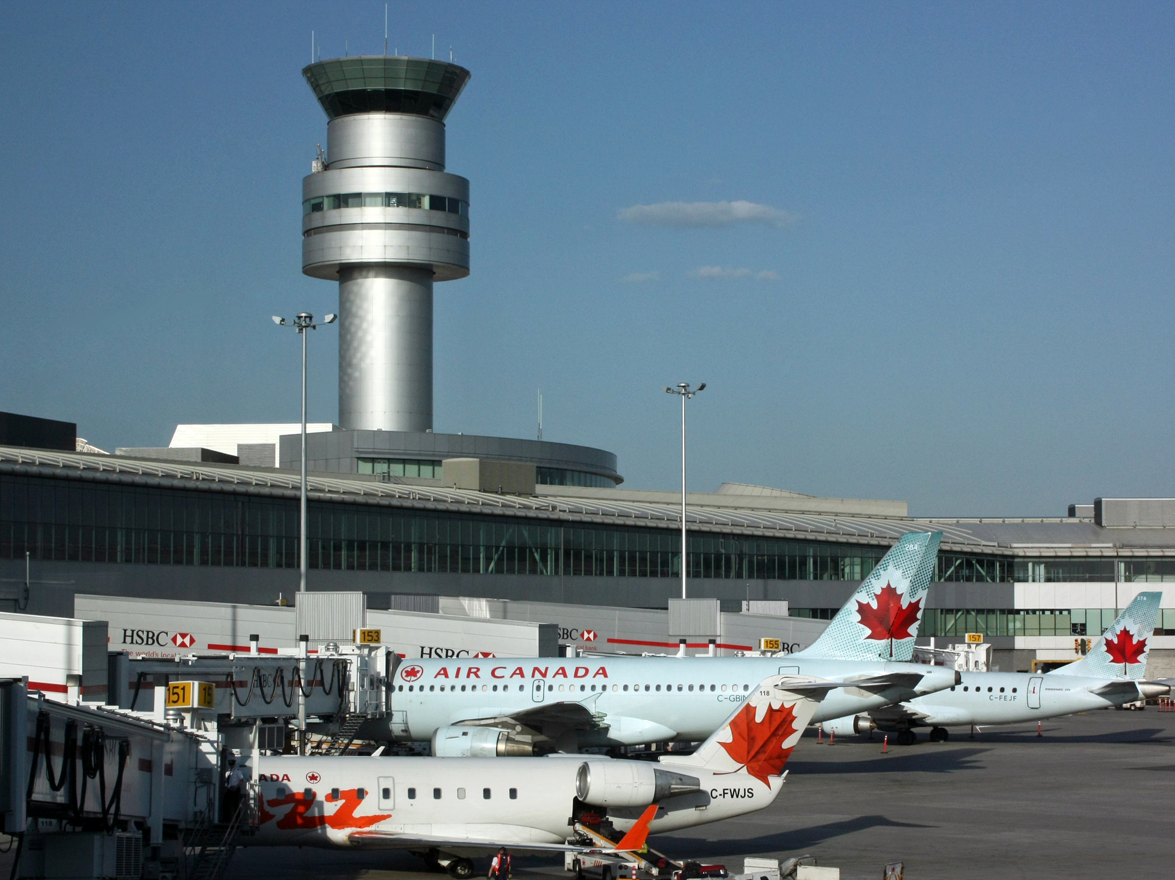
Methods of Travel
Drive
First I would drive to the airport and take a shuttle.
Plane
Next I would take some flights to get to Bora Bora.
This Photo by Unknown Author is licensed under CC BY-SA

Slide 4
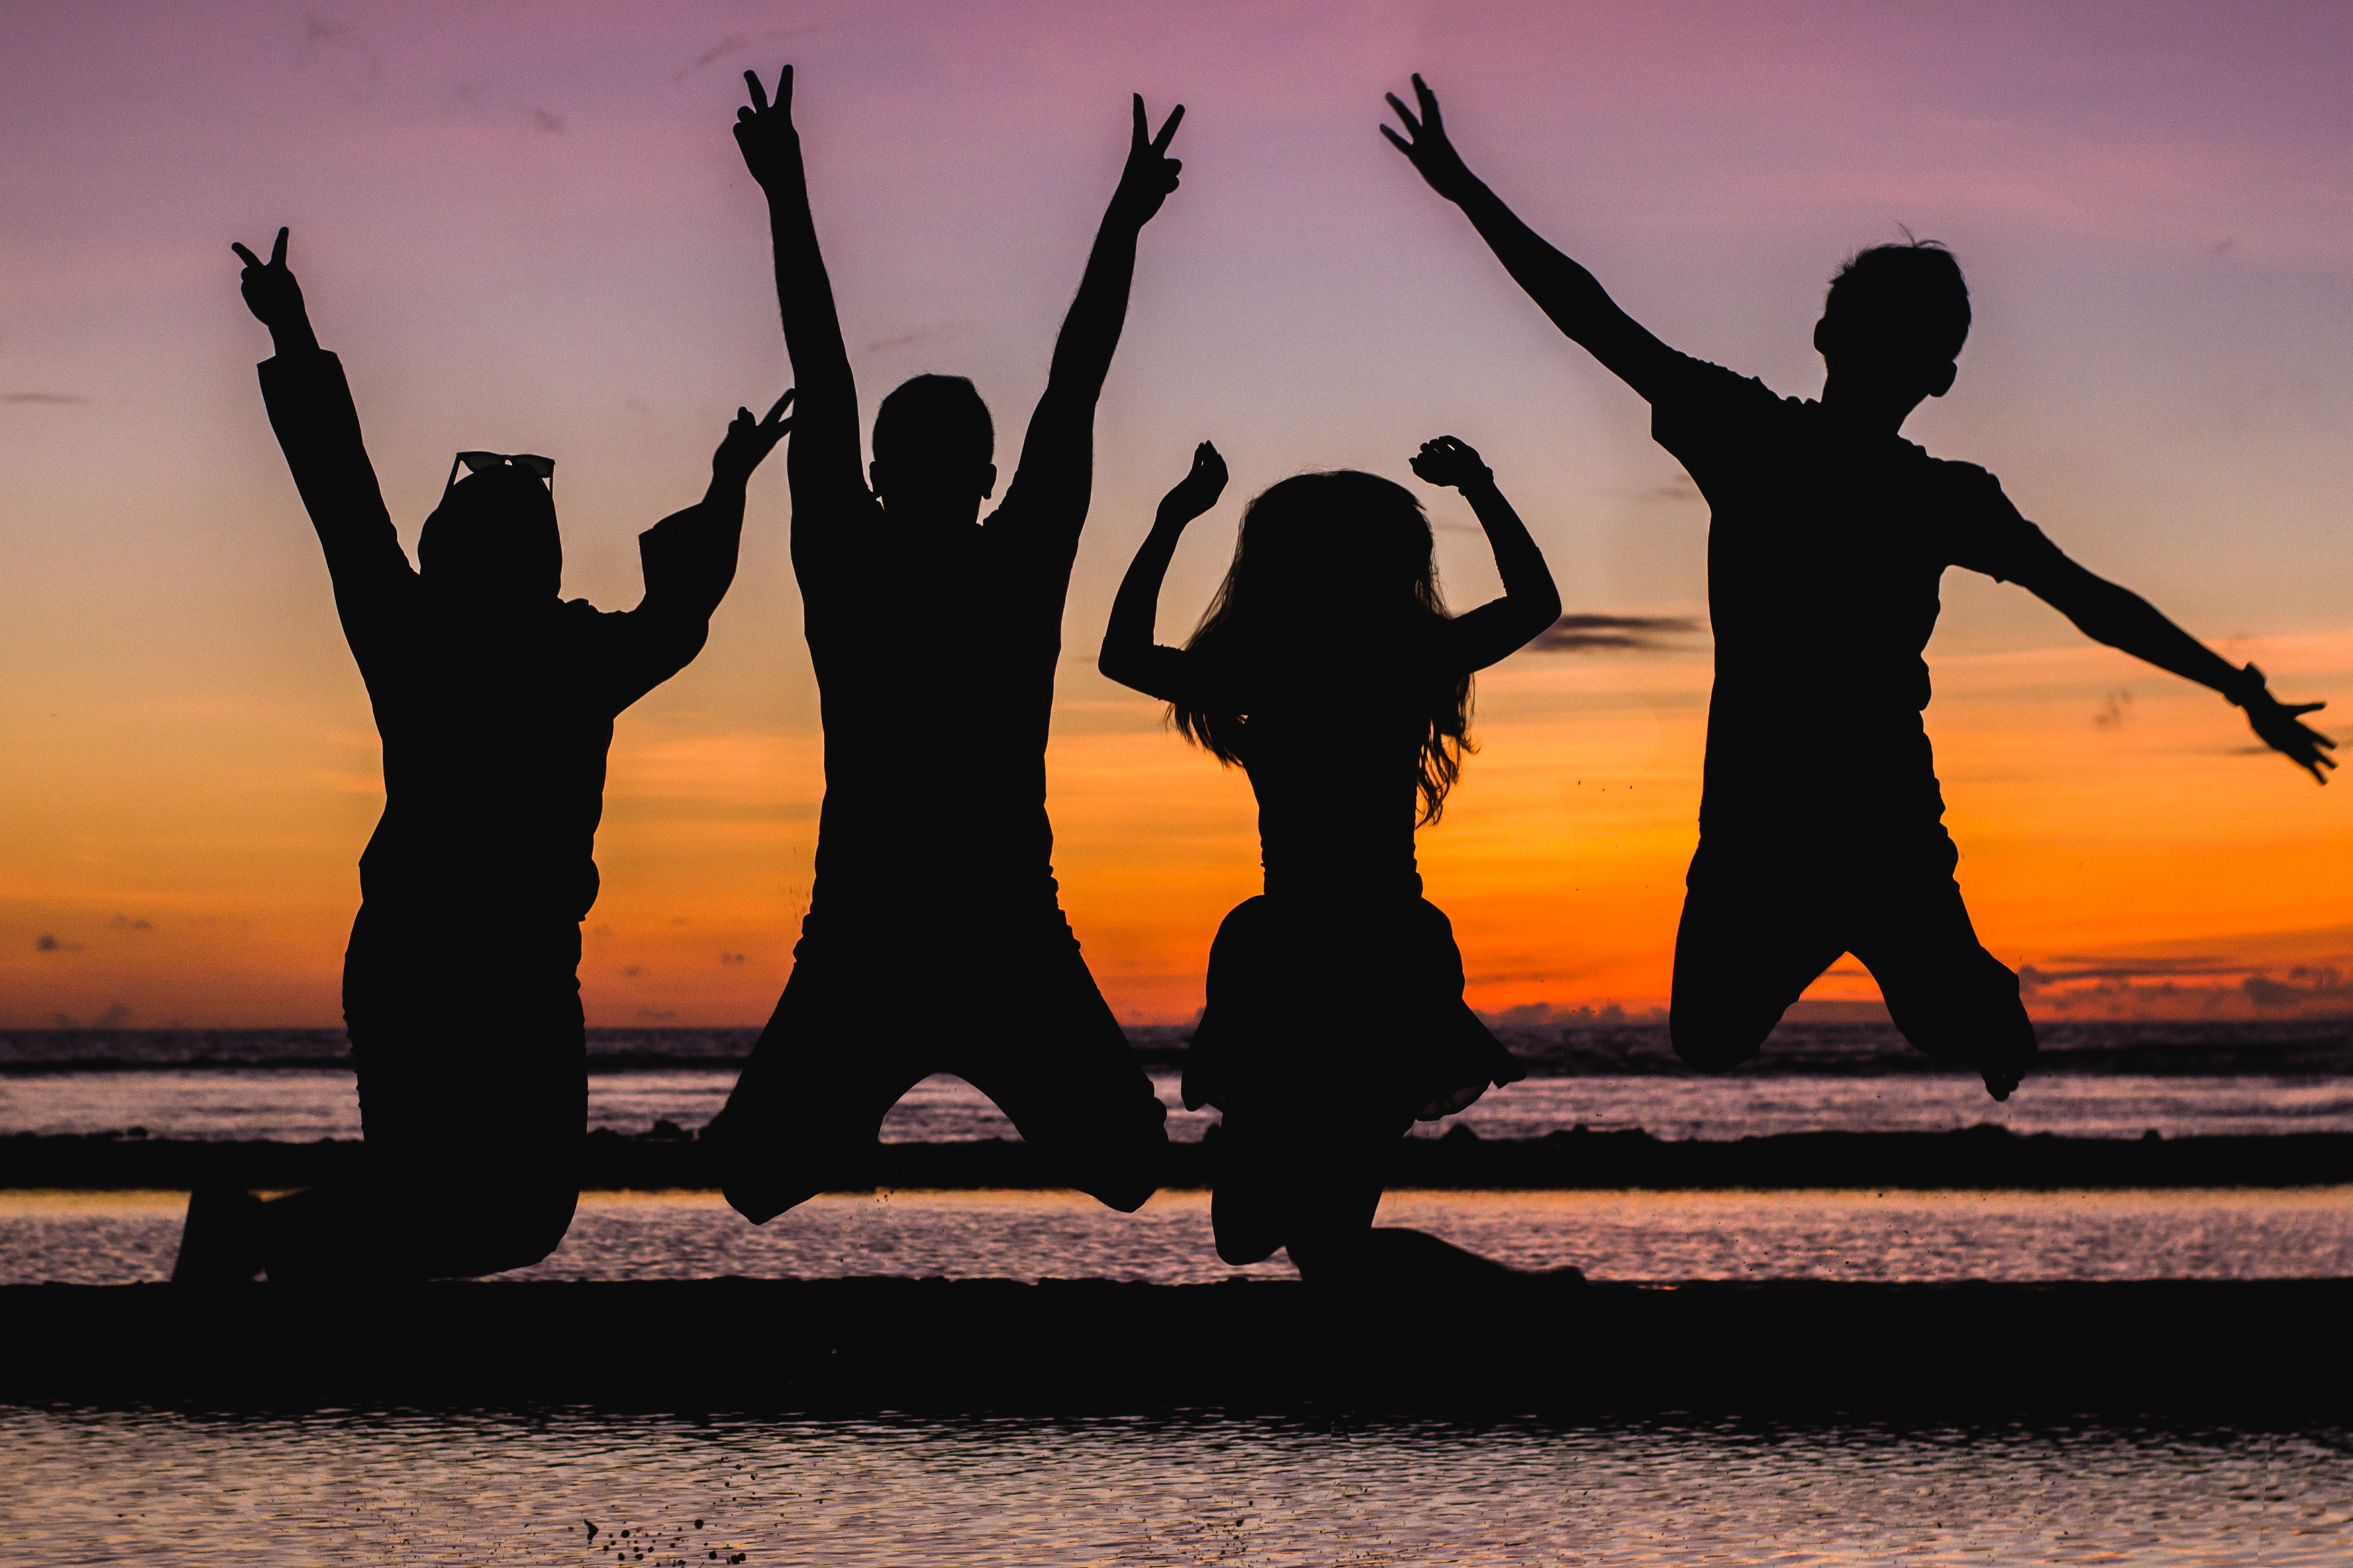
Who Would I Want to Take?
I would want to take my best friend Kendal because we always have so much fun together when we do anything.
I would also want to take my other friend Gracie because I miss her and we have never been on a vacation together.

Slide 5
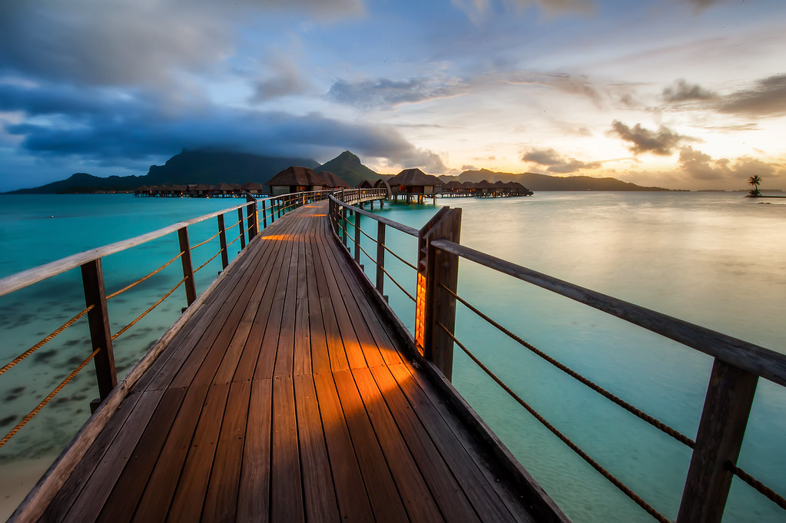
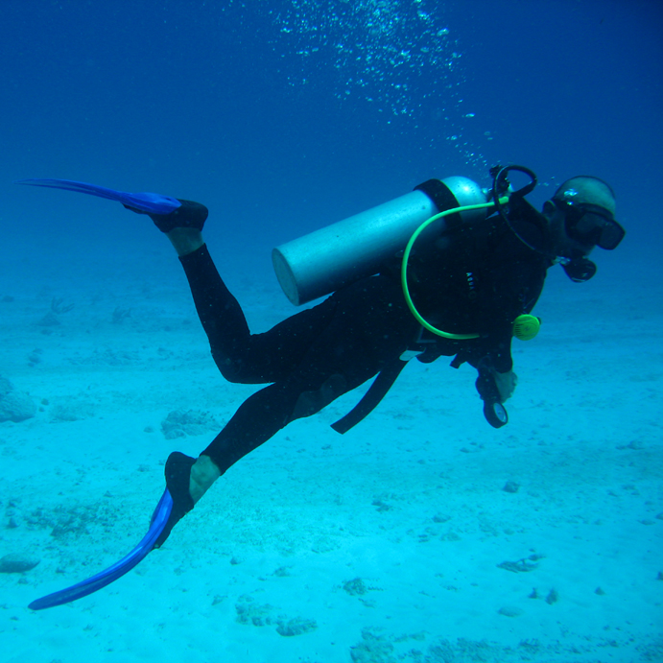
Qualities of Bora Bora
Bora bora is gorgeous and is an amazing place to explore.
Bora Bora also has a unique culture that I would be interested in getting to know.
The beaches sand is like white powder.
There are many things to do there such as snorkeling, scuba diving, parasailing, fishing, and hiking.
This Photo by Unknown Author is licensed under CC BY-SA
This Photo by Unknown Author is licensed under CC BY-NC

Slide 6
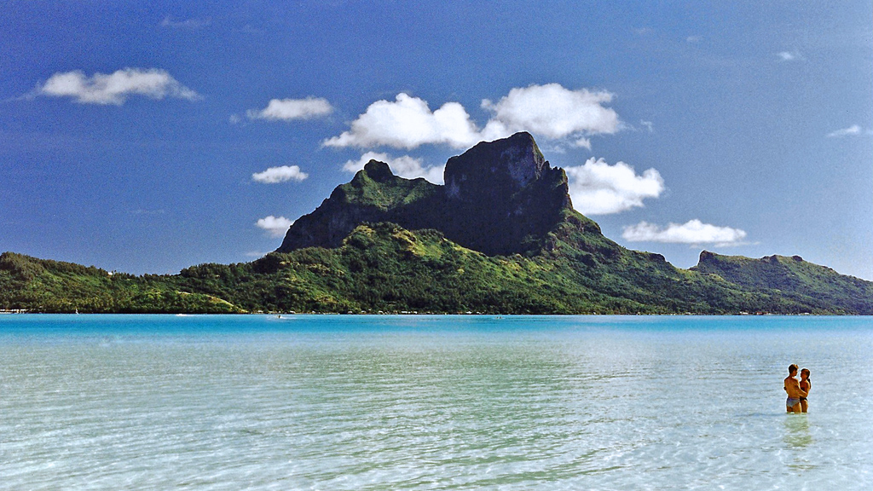
Places In Bora Bora to Visit
I would like to visit Mount Olemaun. This is a great place to hike and is known for its incredible views.
I would also like to visit the catamaran sails. These sails peer through the glass so u can see right through the ocean.
One cultural place I would like to visit would be the Wheel Drive island Tour. This tour takes you on a 3.5 hour trip across the island.
This Photo by Unknown Author is licensed under CC BY-SA

